Slide 1
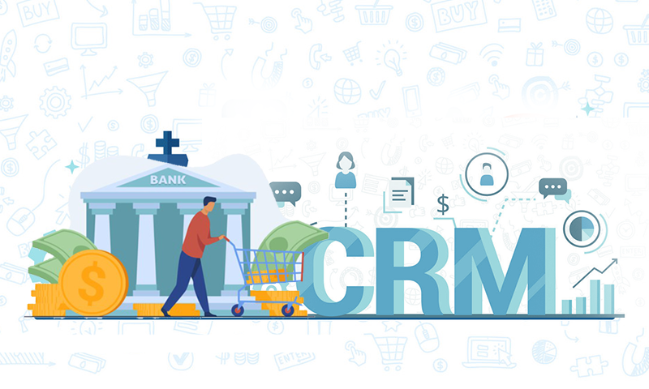

Bank CRM Analysis
Presented by Rajat
24/02/2026

Slide 2

Agenda
About CRM Bank
Problem Statement
Data Description
Objective Key Metrics and Visualizations
Subjective Question for Insights
Recommendation

Slide 3
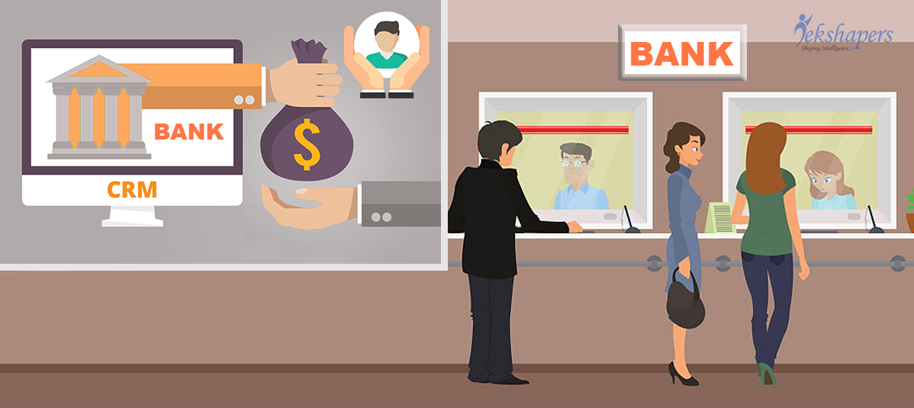
About Bank CRM
Bank CRM (Customer Relationship Management) is a specialized software system used by financial institutions to centralize customer data—such as transaction history, demographics, and preferences—across all channels.
CRM system also tracks customer behaviors and trends, all of which can be used to identify new sales opportunities and improve marketing strategies.
Top CRM tools include Salesforce, HubSpot, and Zoho for comprehensive features. Pipedrive excels in sales pipeline management, while Monday.com is known for user-friendliness and easy adoption.

Slide 4

Business Goal
The bank is experiencing customer churn and inconsistent service satisfaction despite having extensive customer data. However, insights from demographics, transactions, exit records, and active customer profiles are not fully leveraged for decision-making.
There is a need to analyze and integrate these datasets to:
Identify key factors driving customer churn
Detect at-risk customers early
Improve service delivery and customer experience
Develop data-driven retention strategies

Slide 5
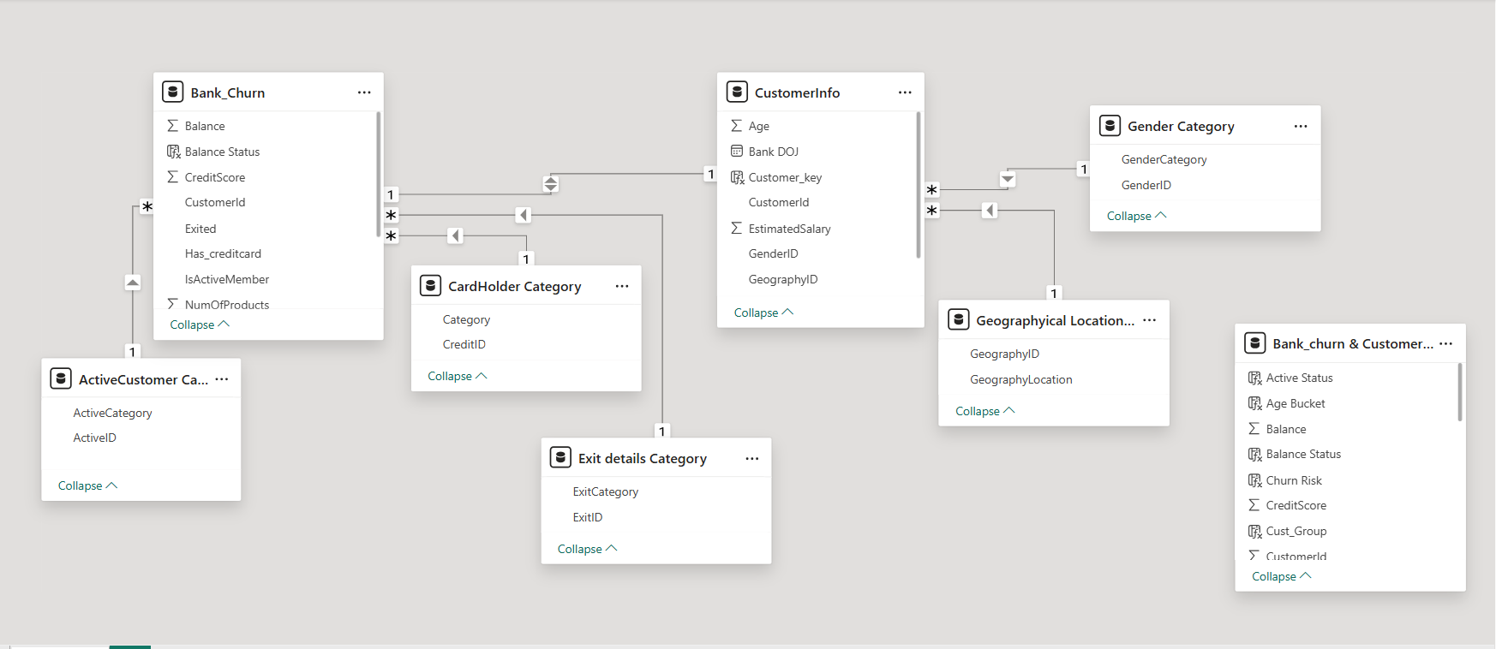
Database Schema

Slide 6
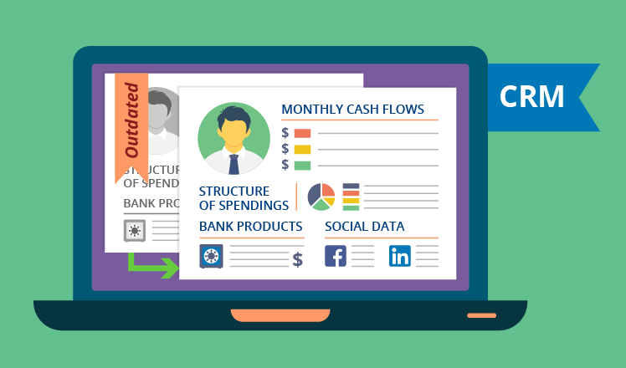
Data Description
The dataset gives us brief overview of Bank CRM Customer’s activities.
The dataset consists of 7 relational tables that are connected to each other.
Total Customer is 10k present across 3 different regions Spain, Germany, France.
Credit Score: A numerical representation of the customer's creditworthiness.
Tenure: The number of years the customer has been with the bank.
Exited: whether or not the customer left the bank.

Slide 7

Methodology
Understanding The Data
Cleaning The Data
Exploring The Data
Deriving Key Insights

Slide 8
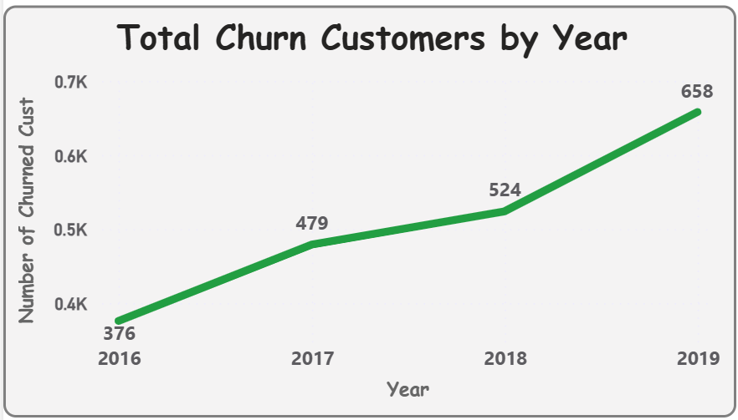
Analysis of Data
Insights:
Consistent Increase in Churn Customer churn rises every year: 376 (2016) → 479 (2017) → 524 (2018) → 658 (2019)
Sharp Growth in 2019 The biggest jump occurs between 2018 and 2019 (+134 customers), indicating a potential service, pricing, or competitive issue.
Overall Growth Trend Churn increased by ~75% over four years (376 → 658), signaling a growing retention problem.

Slide 9
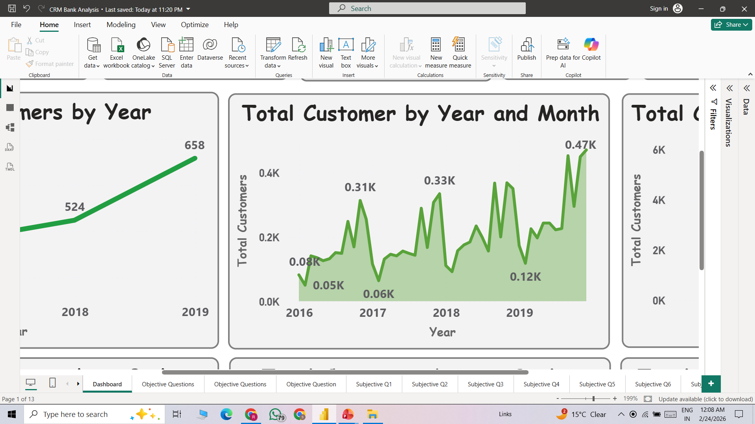
Analysis of Data
Insights:
Customer Base Expansion The average monthly customer count increases year over year, showing consistent business expansion.
Higher Monthly Peaks Each Year Peak values rise annually (≈0.31K → 0.33K → 0.47K), indicating stronger acquisition performance over time.
Recurring Monthly Dips Noticeable drops each year may reflect seasonal slowdowns, reduced marketing activity, or higher churn periods.

Slide 10
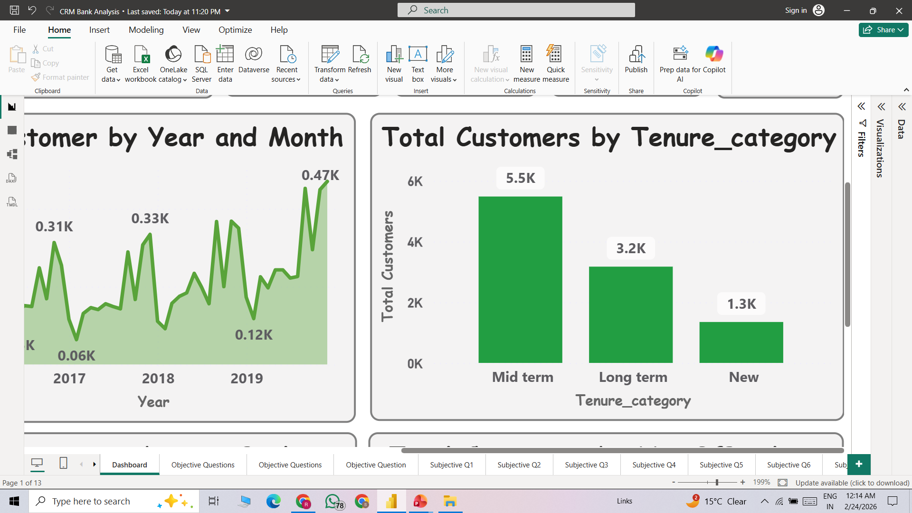
Analysis of Data
Insights:
Mid Term (5.5K) customers form the largest group
Long-term customers (3.2K) are fewer, showing some drop-off after mid tenure.
New customers (1.3K) are the lowest, indicating lower acquisition.
Focus on converting mid-term customers to long-term and improve new customer acquisition.

Slide 11
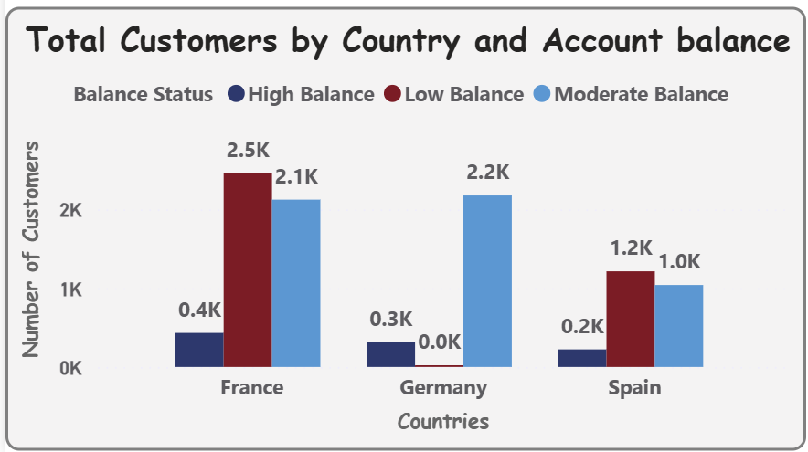
Analysis of Data
Insights:
France has the highest number of Low Balance customers (2.5K) Indicates many customers maintain smaller balances. Opportunity to upsell savings/investment products.
Germany has the highest Moderate Balance customers (2.2K) Majority customers fall in mid-range balance. Strong potential to convert Moderate to High balance segment.
High Balance customers are lowest in all countries France 0.4K, Spain 0.2K, Germany 0.3K.

Slide 12
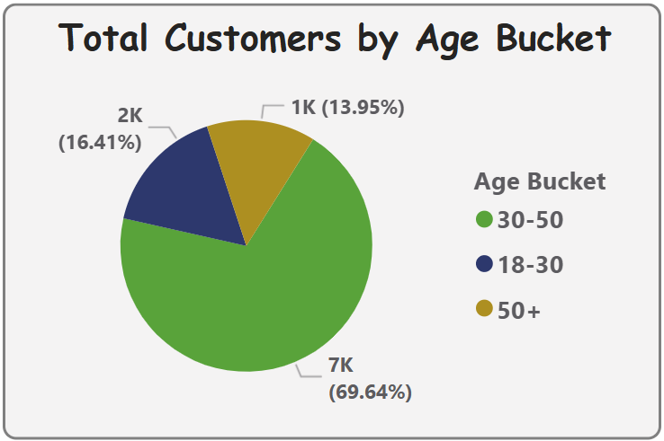
Analysis of Data
Insights:
Majority customers are aged 30–50 (69.64% | 7K customers) Core customer segment of the bank.
Young customers (18–30) make up 16.41% (2K) Growth opportunity through digital & youth-focused products.
Senior customers (50+) represent 13.95% (1K) Smaller segment but potential for retirement & investment products.

Slide 13
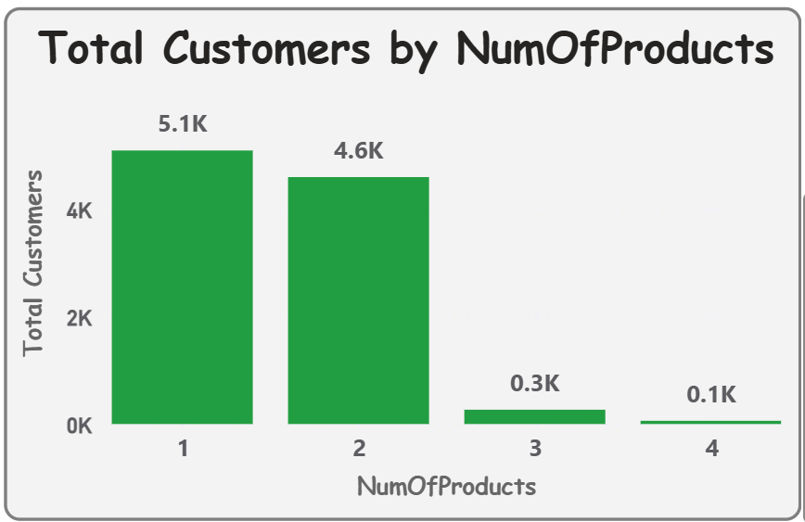
Analysis of Data
Insights:
Majority customers use only 1 product (5.1K) Indicates low product penetration.
4.6K customers use 2 products Good cross-selling success at this level.
Very few customers use 3 (0.3K) or 4 products (0.1K) Strong opportunity to increase multi-product adoption.

Slide 14
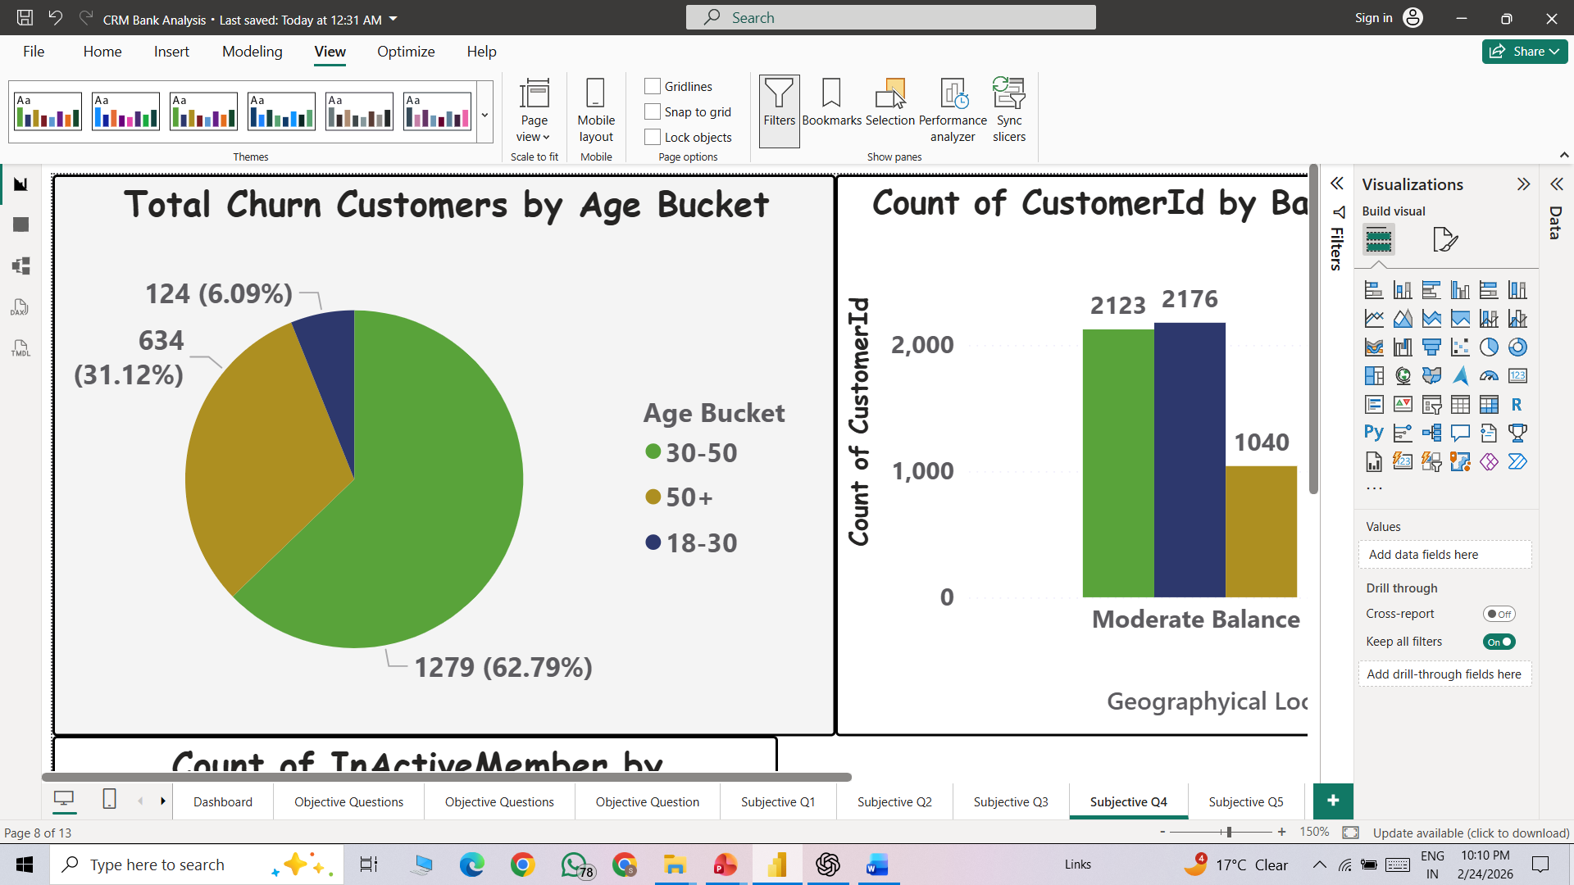
Analysis of Data
Insights:
Highest churn comes from age 30–50 (62.79% | 1279 customers) Core customer segment is also the most at risk.
50+ customers contribute 31.12% (634 churns) Significant churn among senior customers.
Lowest churn is from 18–30 age group (6.09% | 124 churns) Younger customers are relatively more retained.

Slide 15
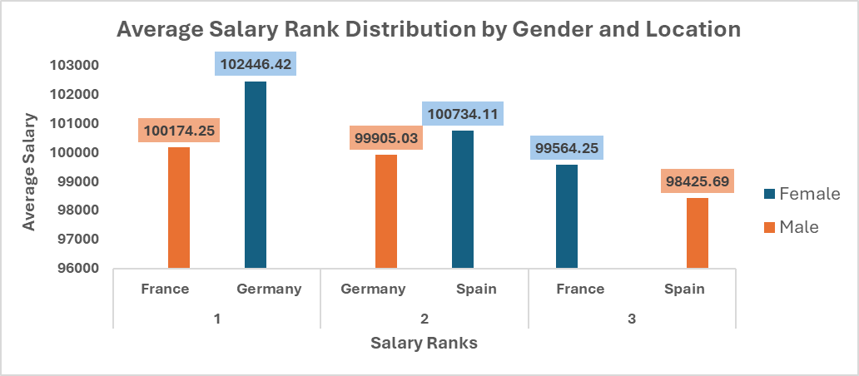
Analysis of Data
Insights:
Germany has the highest average salary levels.
Spain has the lowest average salary levels.
Female customers have slightly higher average salaries than males

Slide 16
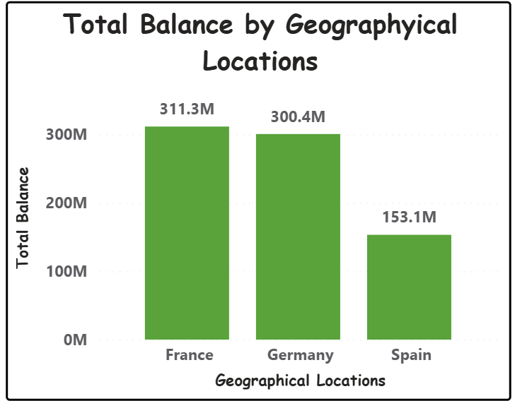
Analysis of Data
Insights:
France has the highest total balance (311.3M).
Germany is slightly lower but close to France (300.4M).
Spain has significantly lower total balance (153.1M)
France and Germany together hold the majority of the bank’s total funds.

Slide 17
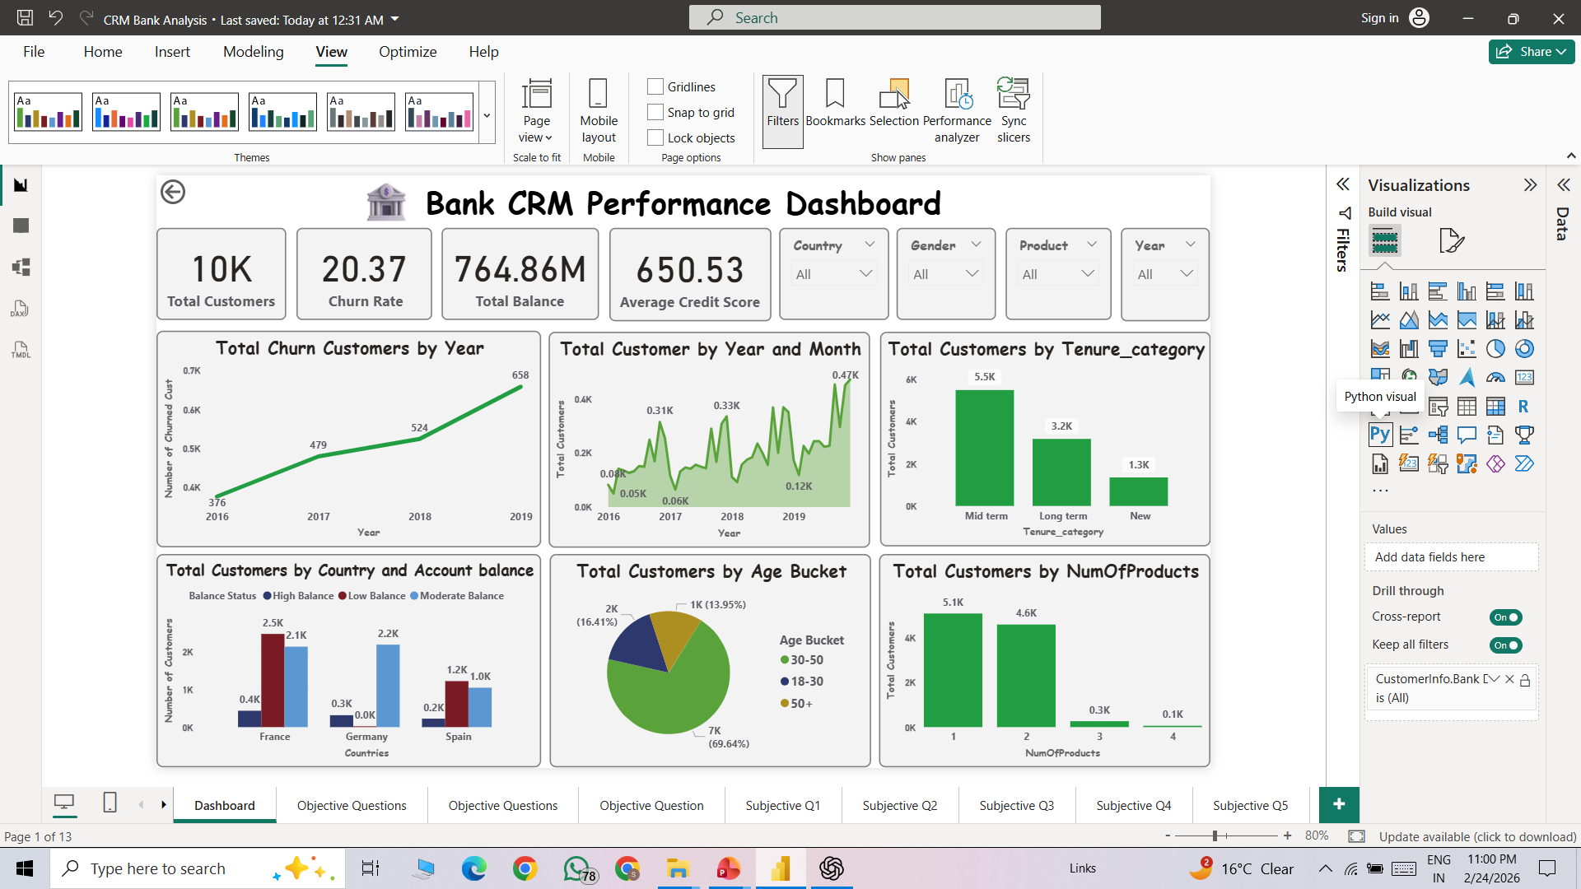
Dashboard and Visualization

Slide 18
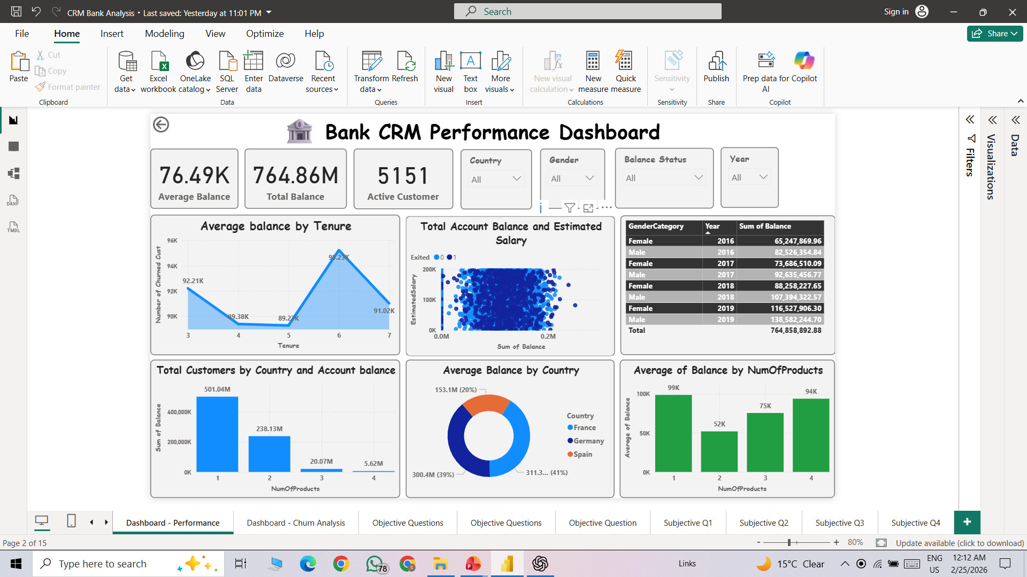
Dashboard and Visualization

Slide 19
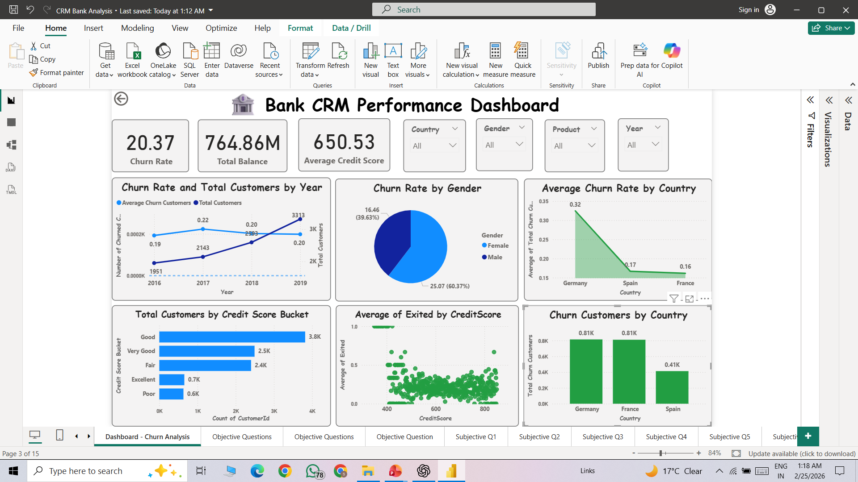
Dashboard and Visualization

Slide 20
Conclusion
The bank has 10K total customers with a 20.37% churn rate, indicating a noticeable retention challenge.
Churn is increasing year by year, requiring immediate customer retention strategies.
The 30–50 age group forms the majority of customers and also contributes most to churn.
France and Germany contribute the highest total balance, while Spain shows growth potential.
Most customers use only 1 or 2 products, showing strong cross-selling opportunities.

Slide 21
Recommendation
Focus more on customers aged 30–50, because most customers who leave belong to this group.
Encourage customers to use more bank products (like credit cards, loans, savings plans) instead of just one
Introduce loyalty programs, rewards, or special benefits to reduce customer churn.

Slide 22
Recommendation
Work on increasing deposits in Spain, as its total balance is lower compared to France and Germany
Maintain strong relationships with customers in France and Germany to keep balances high and prevent churn.
Improve customer engagement through regular communication, such as personalized emails, offers, and follow-ups, so customers feel valued and connected to the bank.

Slide 23
Thank You !

